Slide 1
VR / AR

Slide 2

Can(not) you!?
Tell what is VR/AR!?

Slide 3
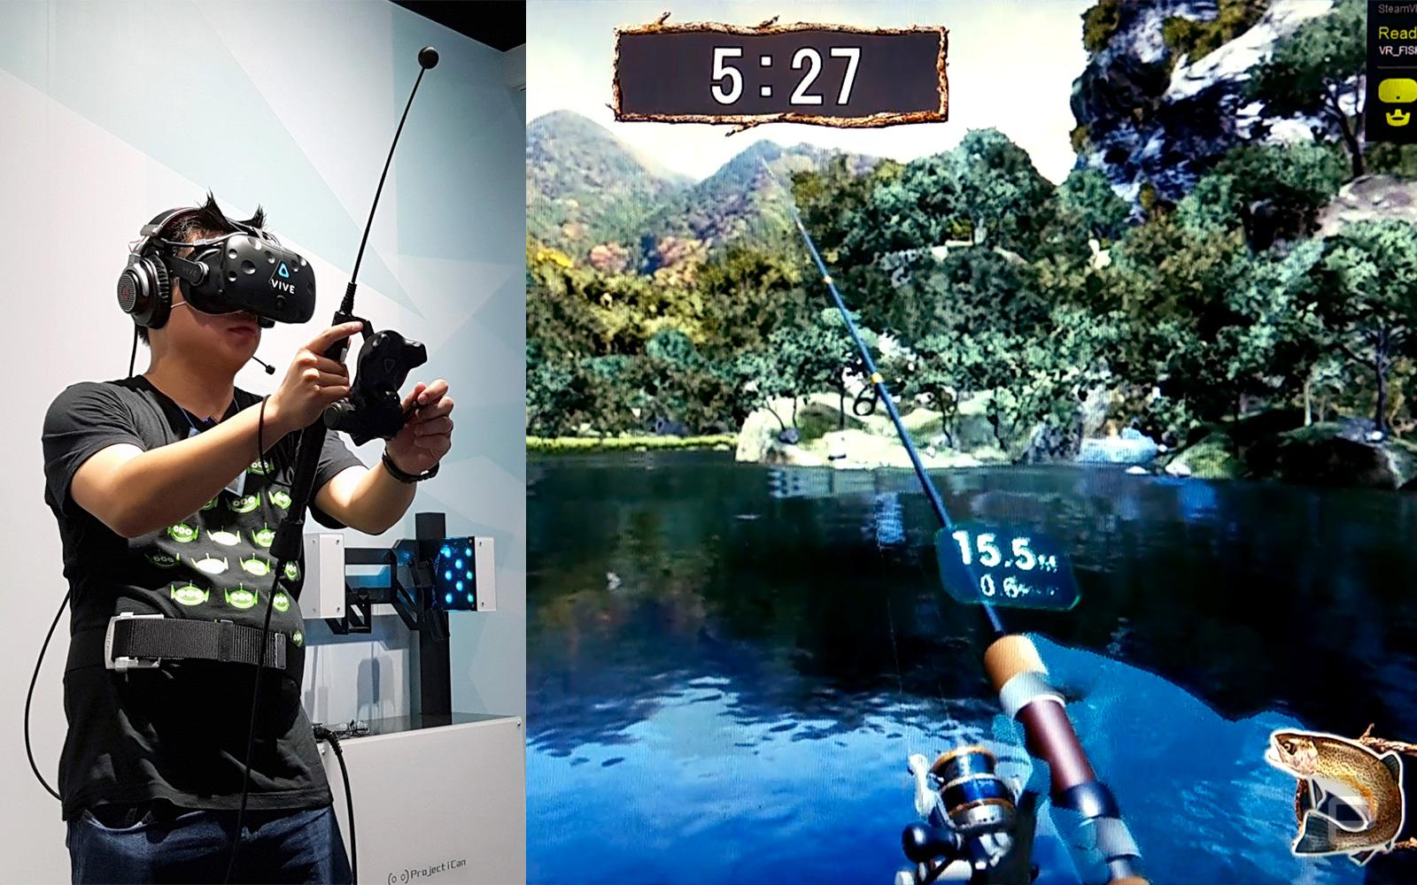
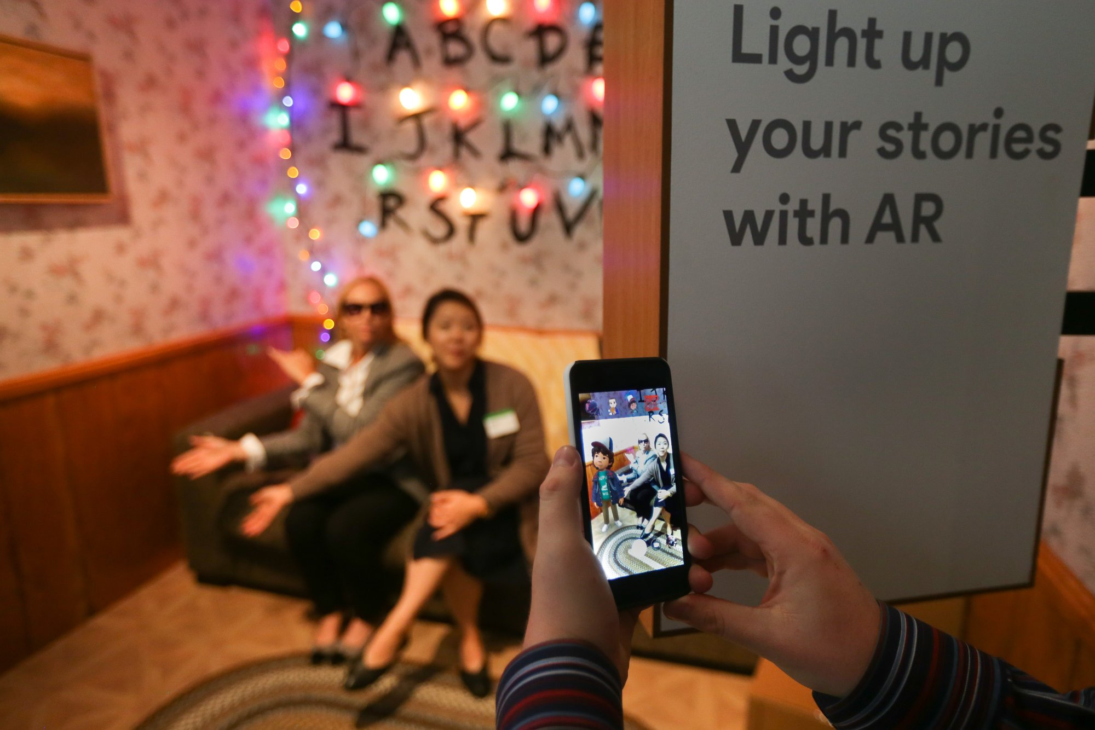
VR
AR
Virtual Reality Augmented Reality
Can take you anywhere. Can bring anything to you.

Slide 4
Virtual Reality
Augmented Reality
Augmented Reality is a technology that layers interactive,virtual enhancements atop an existing reality. It is developed into apps and used on mobile devices which blends digital components.
Virtual Reality is an artificial, computer generated simulation or recreation of a real life environment or situation.It immerses the user primarily by stimulating their vision and hearing.

Slide 5
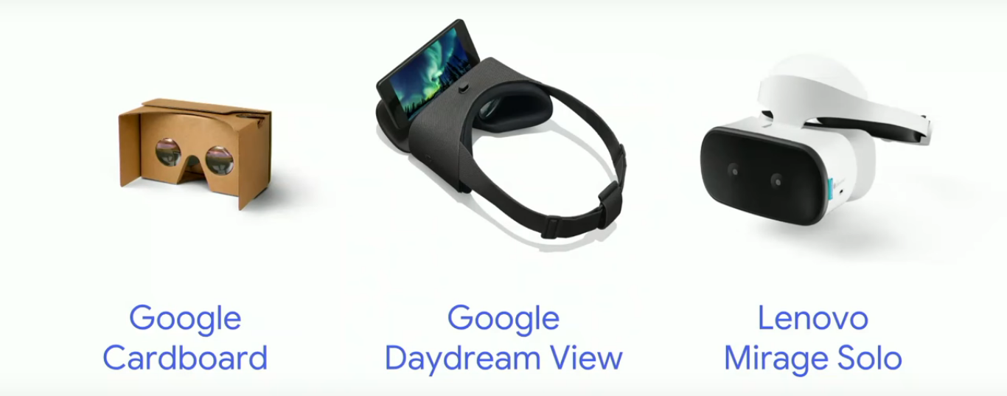
VR headsets

Slide 6
Can(not) you!?
Which amongst 3 headsets has higher specs, than others according to you?
Hint: Nomenclature

Slide 7

Showtime!
Simple VR design: https://codepen.io/rashmi-nagpal/pen/PaQEbP
http://awwwards.unboring.net/

Slide 8
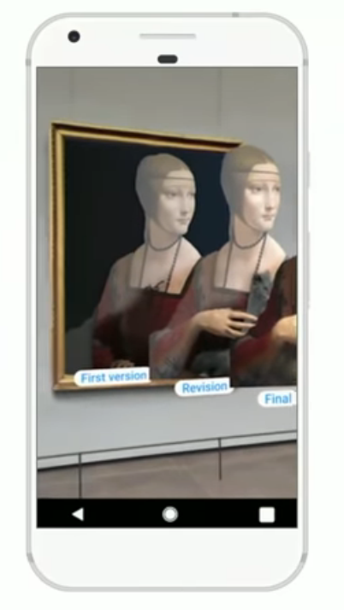
AR marks the next big shift in
mobile computing
AR can bring digital information to you in the context of the real world, right where it’s more accessible and useful.

Slide 9
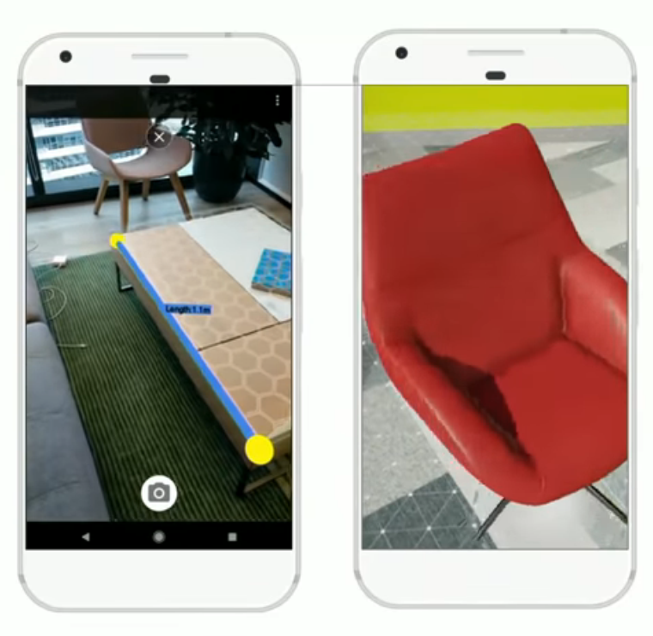
AR can be useful
Build tools and shopping experiences that can understand the geometry of a room.

Slide 10
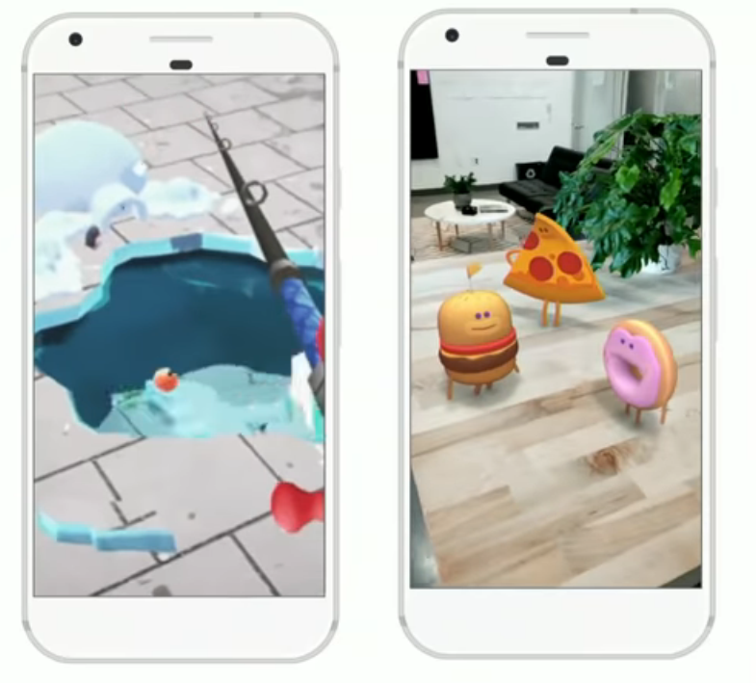
AR can be fun
Build games and creative experiences that interact with the real world.

Slide 11
Showtime!
Simple AR design:

Slide 12
Real environment Augment Reality Augmented virtuality Virtual environment
Reality - virtuality continuum
Mixed Reality
State of the art

Slide 13
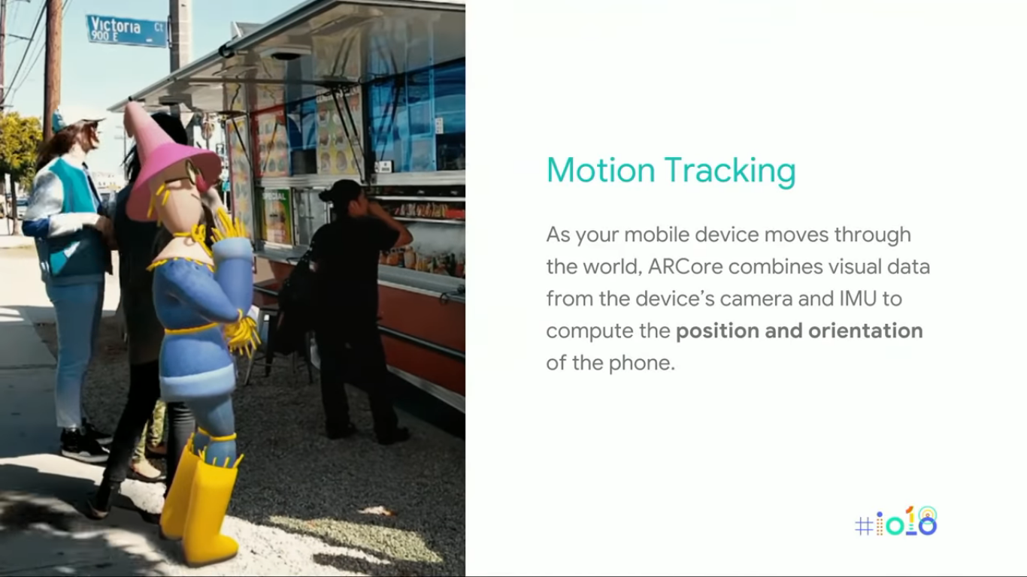
Motion Tracking
As mobile device moves through the world, AR technologies combines visual data from the device’s camera and IMU to compute the position and orientation on the phone i.e we can render virtual object to match into physical environment.

Slide 14
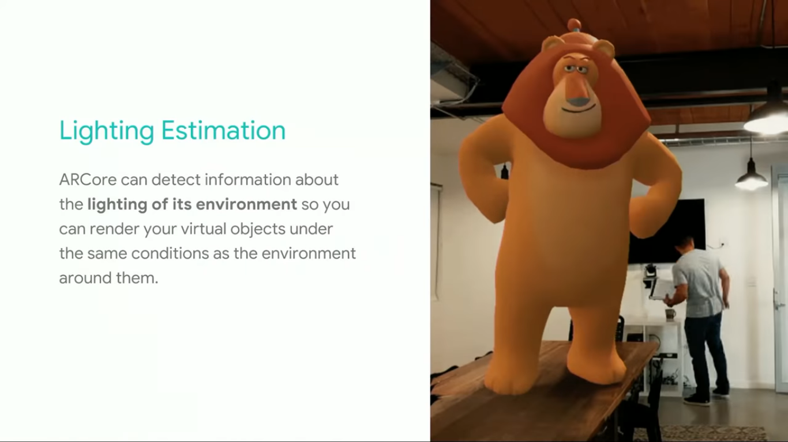
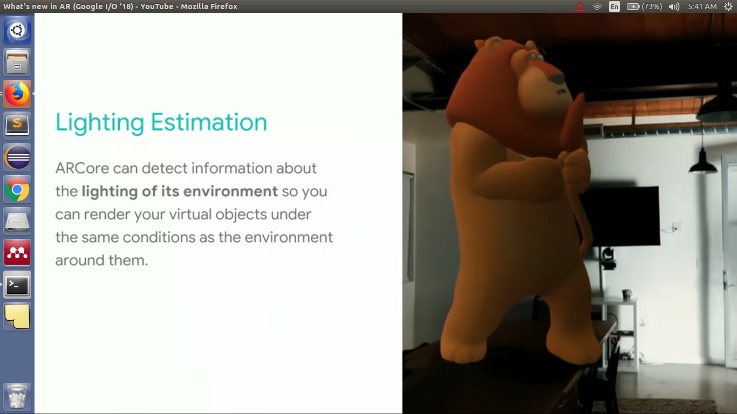
Lighting Estimation
AR technologies can detect information about the lighting of its environment so you can render your virtual objects under the same conditions as the environment around them to have more immersive looks.

Slide 15
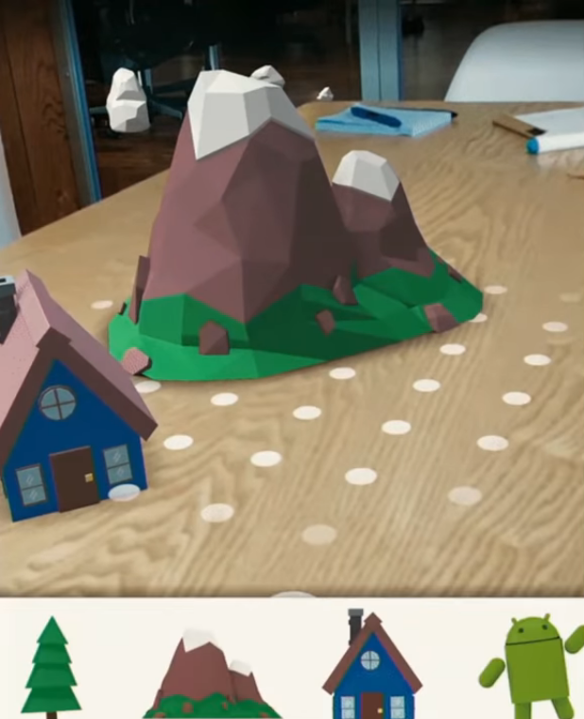
Environment Understanding
AR technologies understands the physical structure of the environment, detecting horizontal surfaces, like tables and desks, and makes these surfaces available to your app as planes.

Slide 16
Can(not) you!?
Tell which amongst the following are AR based apps?
Statik
Pokemon Go
The Lab
Tilt Brush

Slide 17
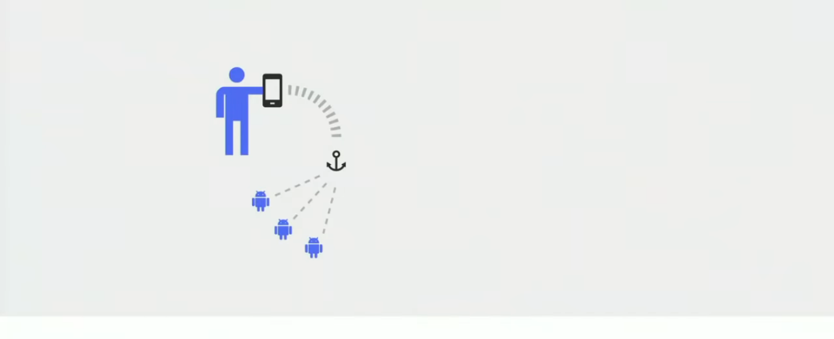
In AR, anchors connect content to the physical world.

Slide 18
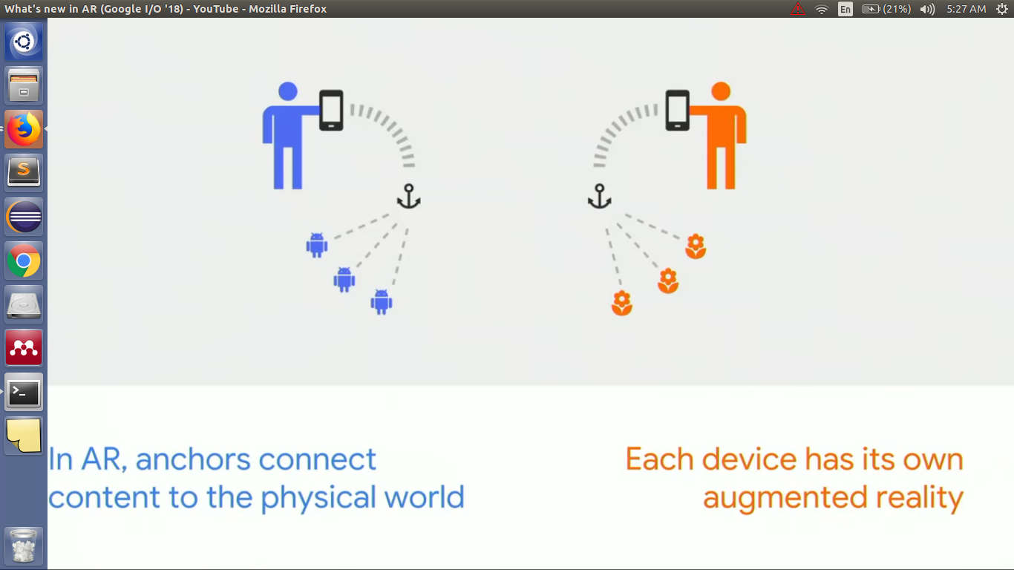
In AR anchors connect content to the physical world.
Each device has its own augmented reality

Slide 19
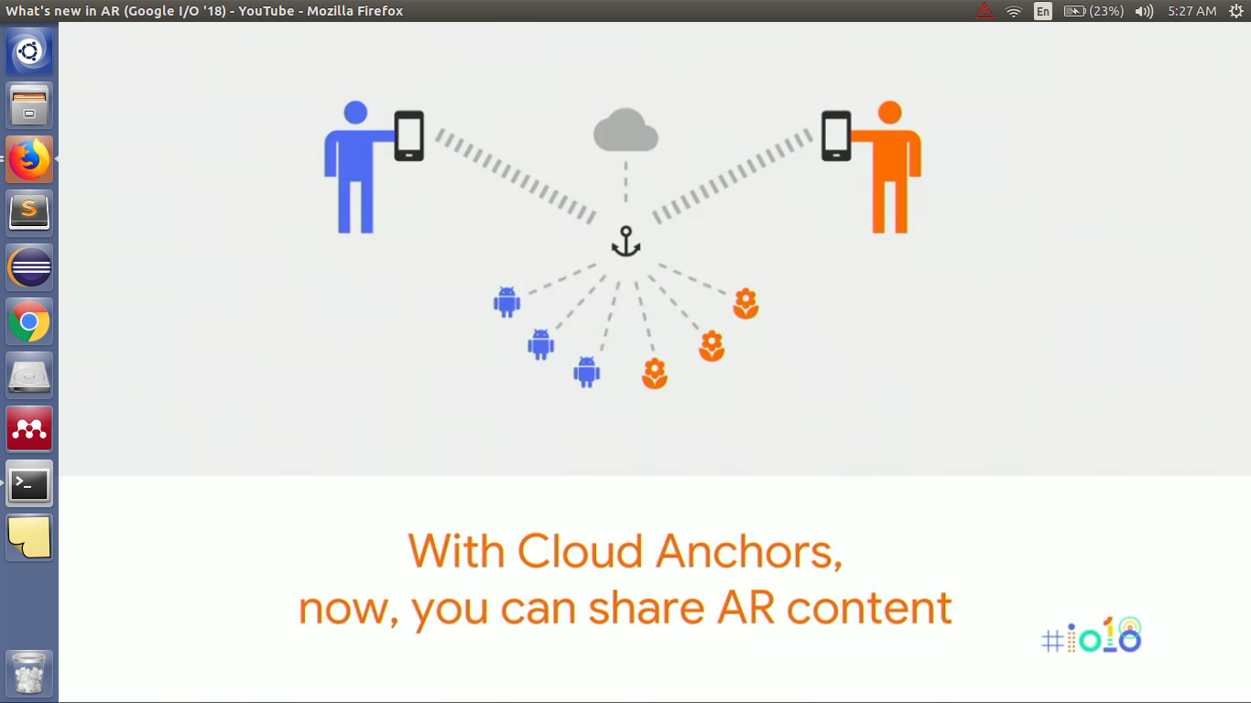
With Cloud Anchors, now, you can share AR content.

Slide 20
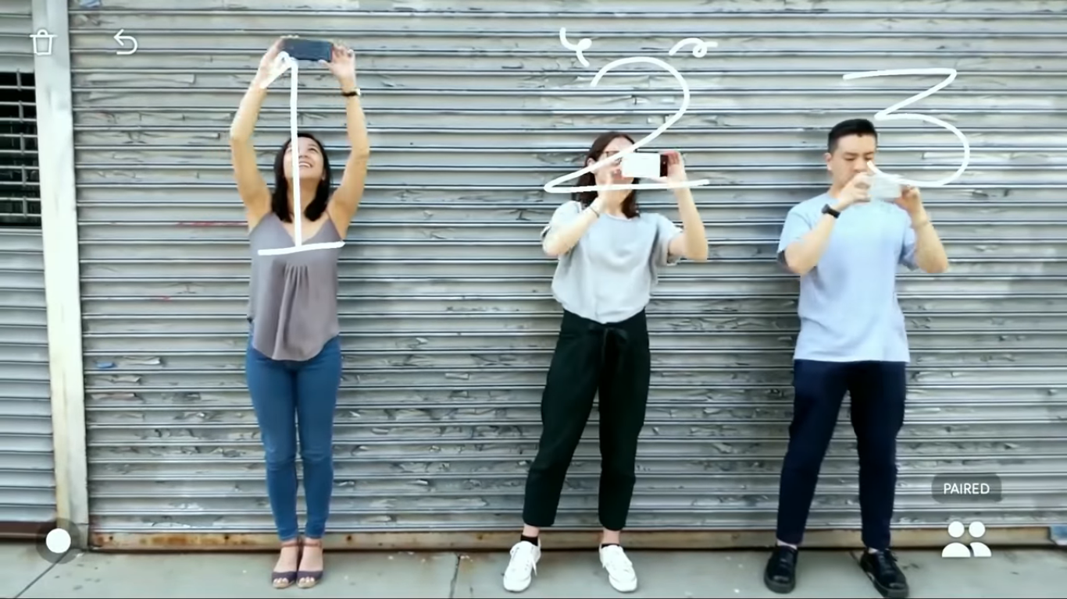

Slide 21
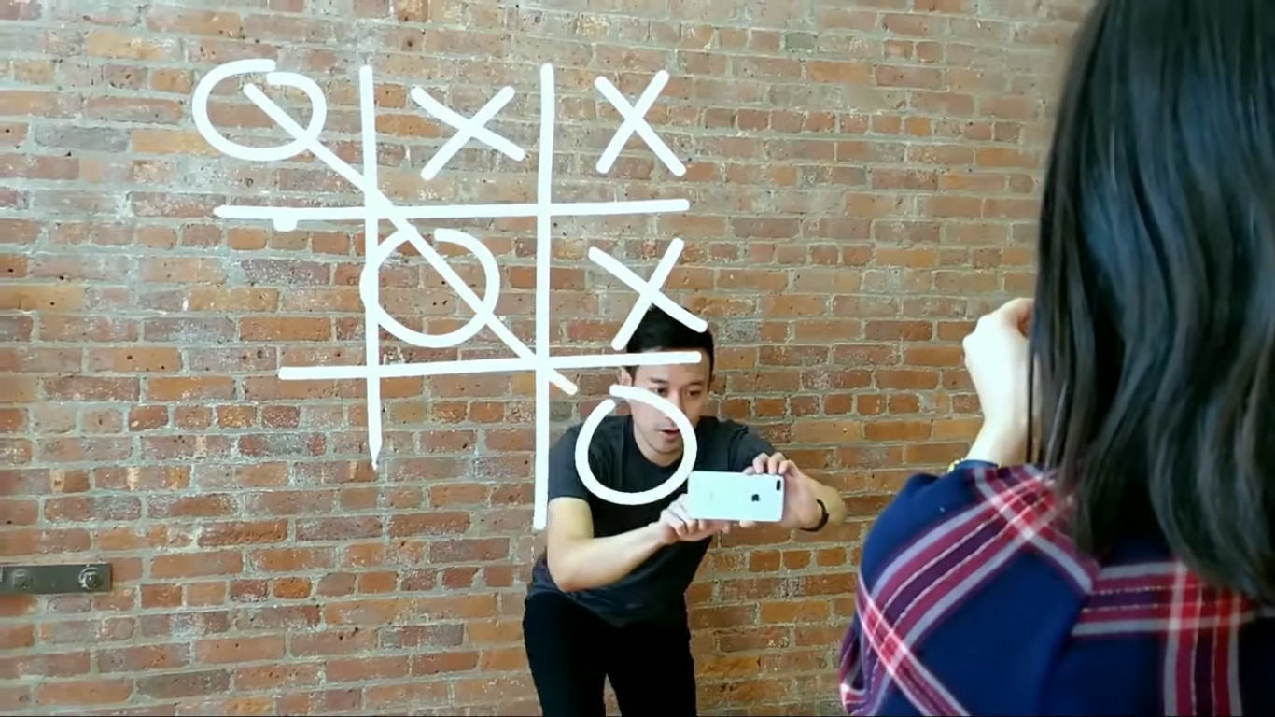

Slide 22
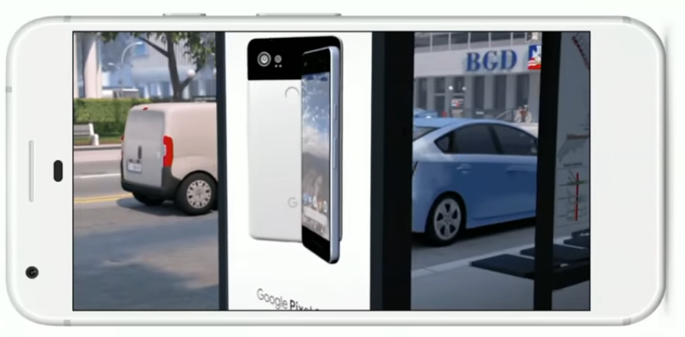
Use cases
Education
Advertising
Products

Slide 23
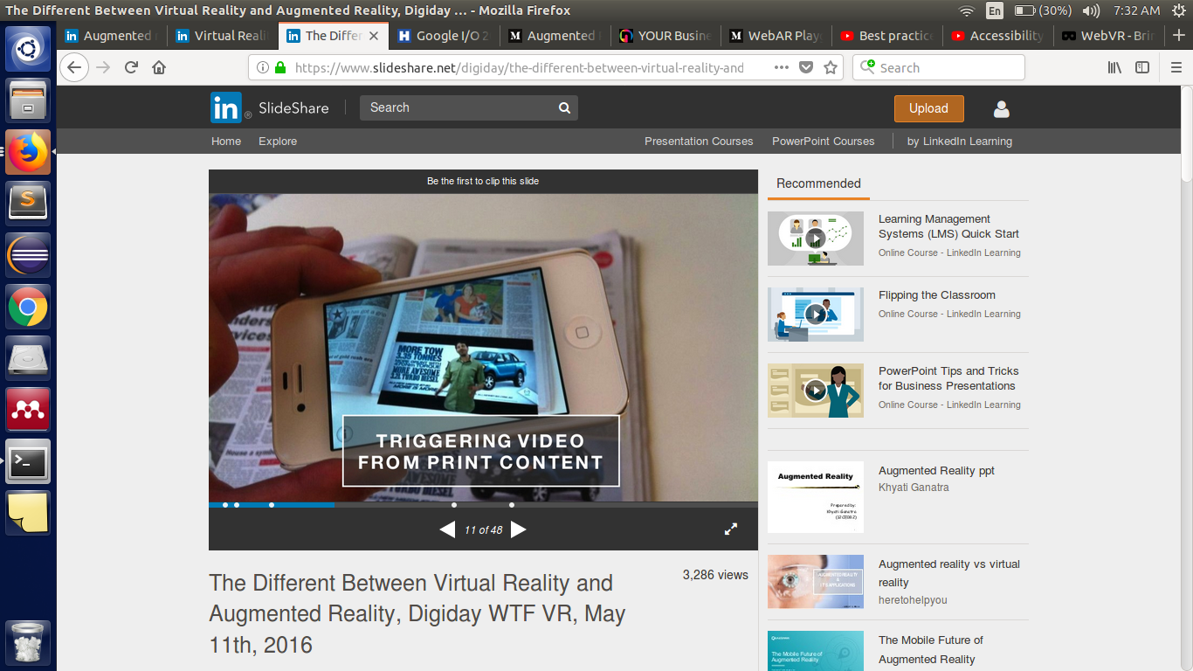
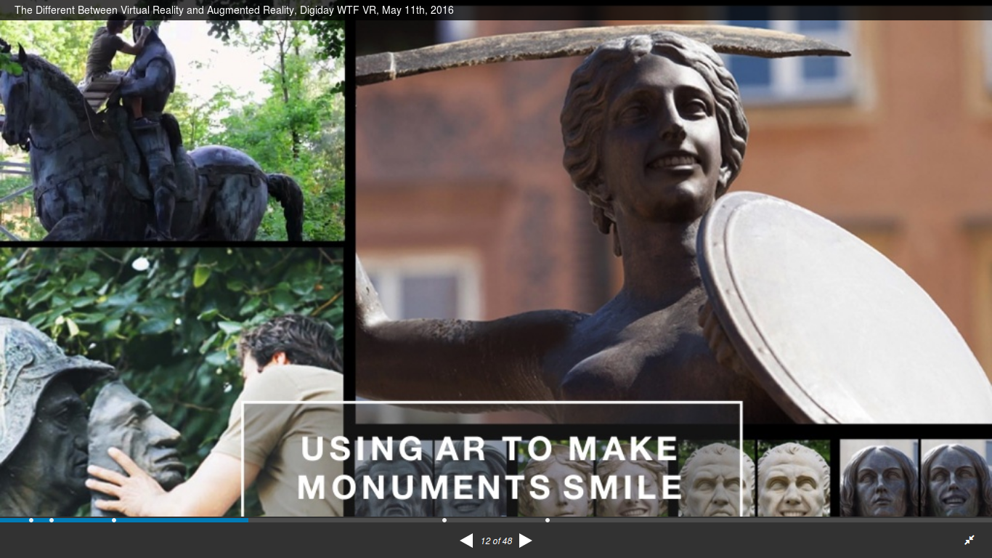

Slide 24
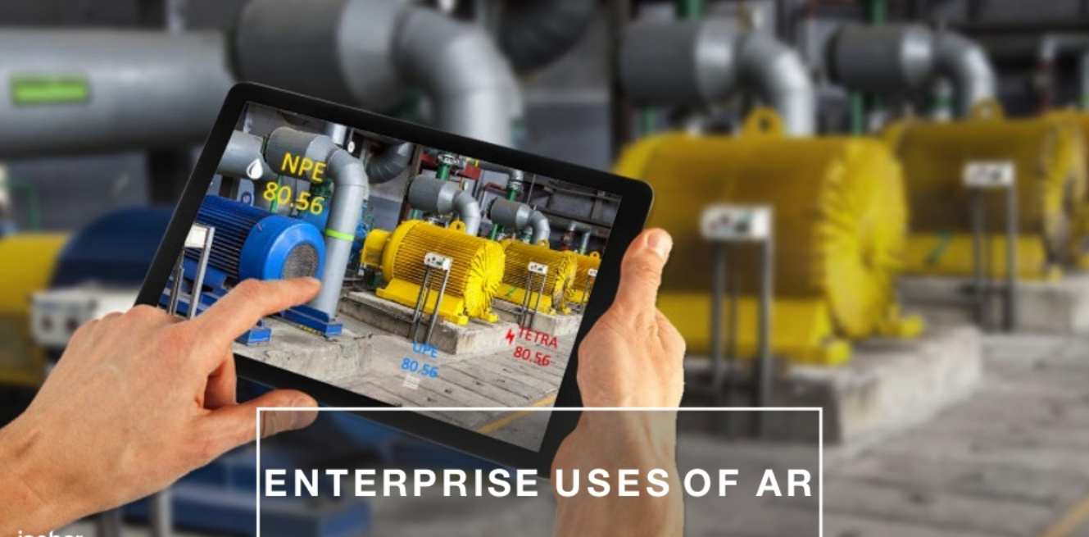

Slide 25
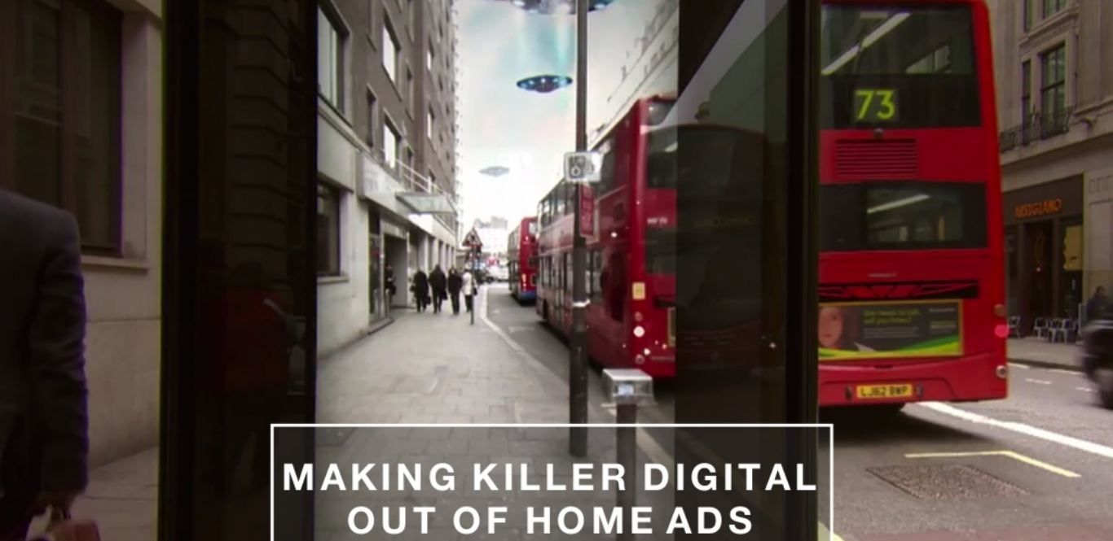

Slide 26
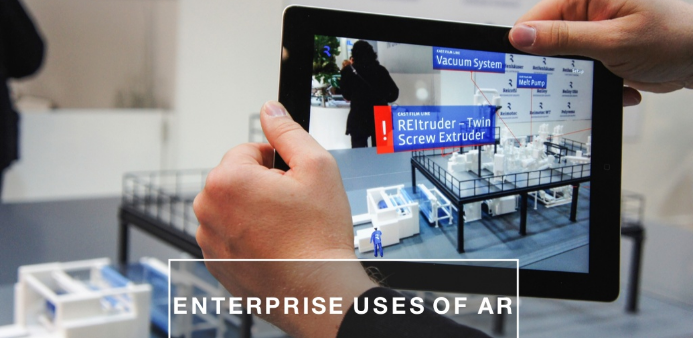

Slide 27
Can(not) you!?
Has VR/AR technologies touched medical services!?

Slide 28
Showtime!
https://www.youtube.com/watch?v=jvBH-sgPyak

Slide 29
Can(not) you!?
Can we use these technologies for less fortunates ones!?
Hint: Visually impaired et al.

Slide 30
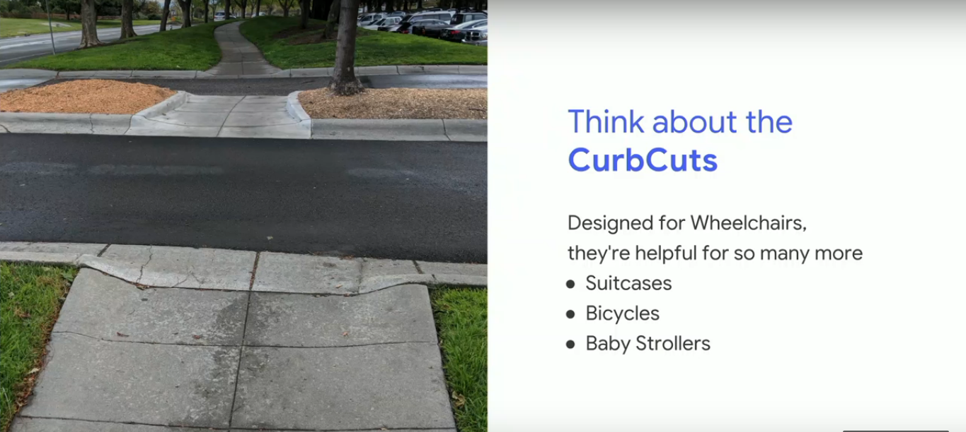

Slide 31
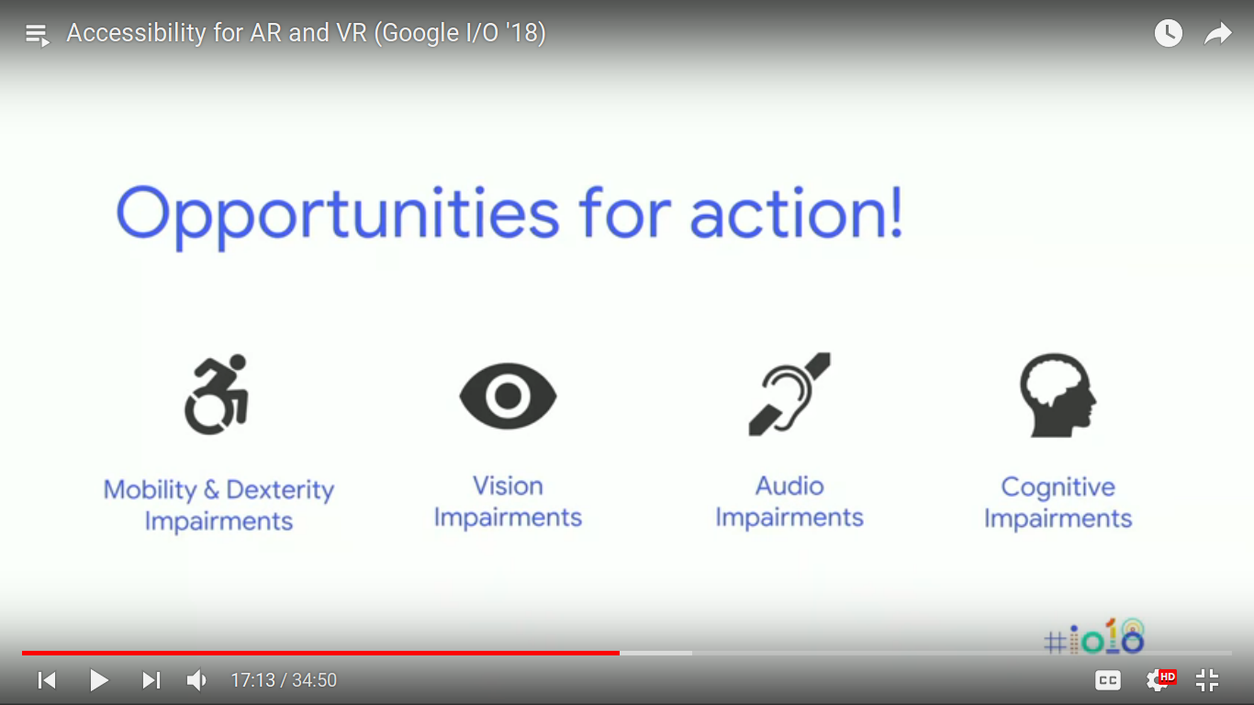
Opportunities for action!

Slide 32
Can(not) you!?
Tell use cases of VR/AR in banking applications!?

Slide 33
Don’t design for yourself,
design for the broadest
possible market.
You’ll be surprised who you’ll be supporting.

Slide 34
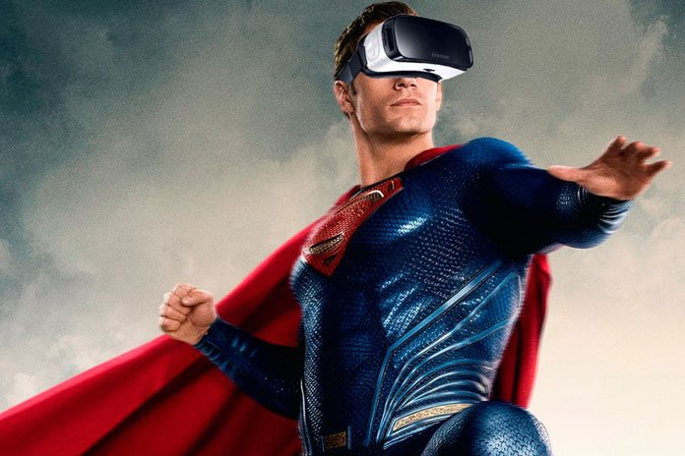
Superpowers!
Augmented and Virtual Reality can give users Super powers!
These “powers” are helpful for everyone, but can be even more impactful for people with disabilities!

Slide 35
Showtime!

Slide 36
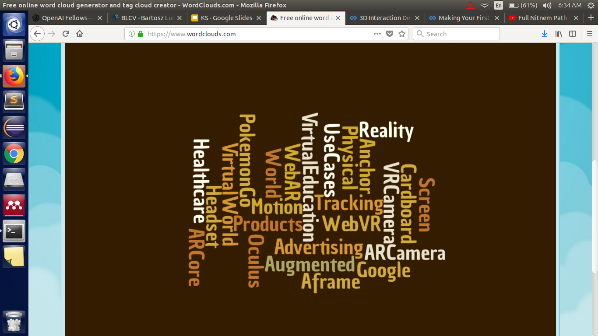
Backtrack to topics

Slide 37
Thanks, a bunch!
To heavy weight lifters:
Amit G.
Rishabh S.
All present!
Over n out!
RN

